Slide 1

Team Horcruxes
HR-Dataset
Members :
Aaditya Patil
John Wesly D
Apurv Raj
Manisha Itha

Slide 2
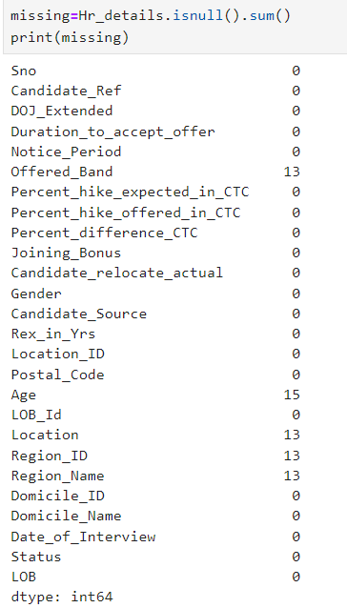
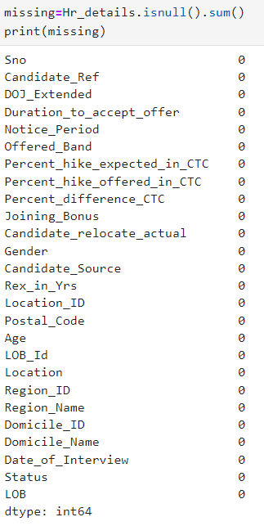
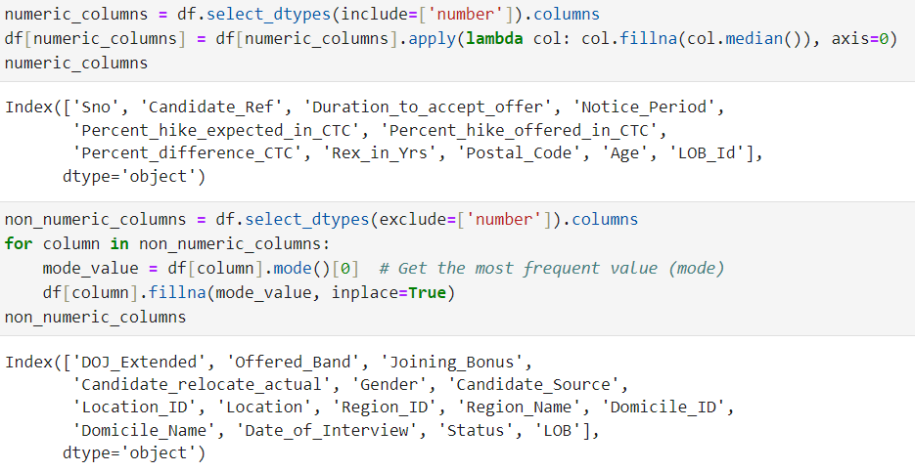
Data Cleaning
Before
After
Methods used -

Slide 3
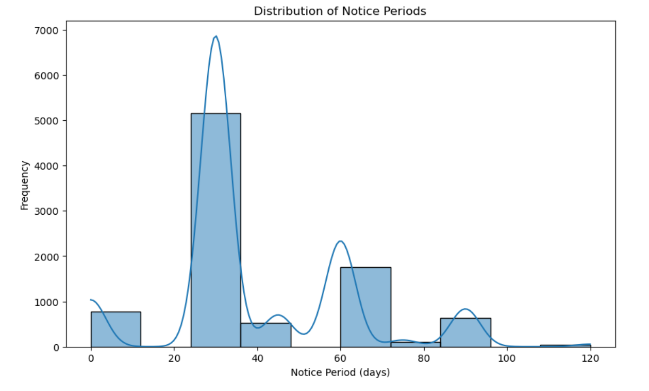
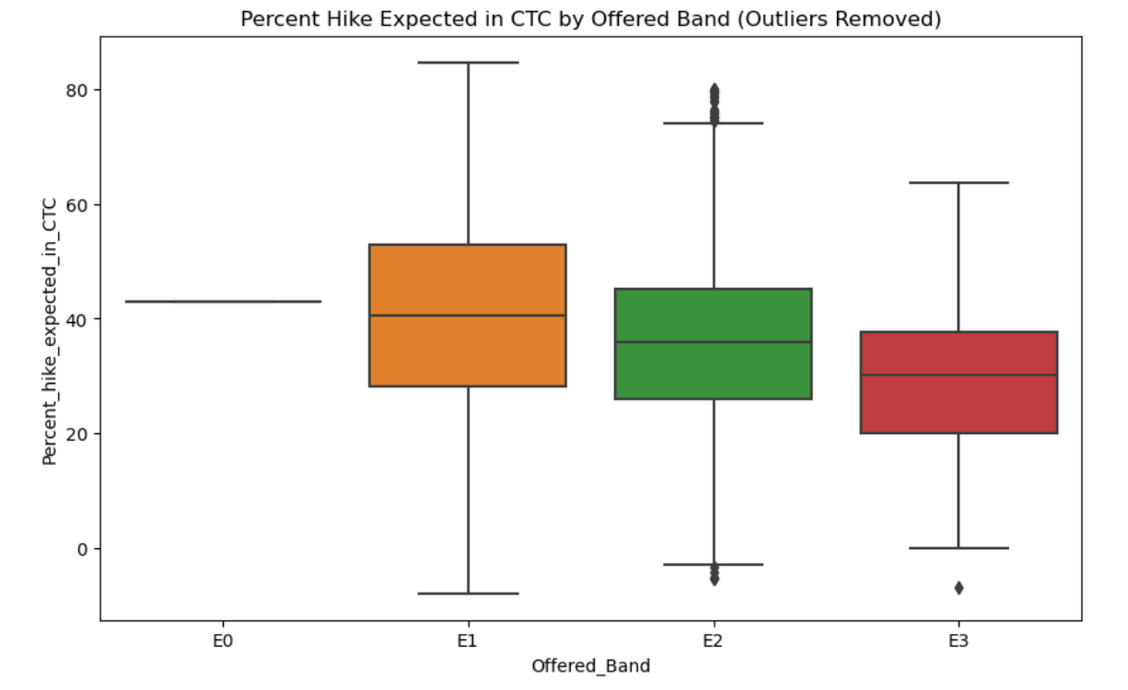
Data Visualization

Slide 4
Relational Schema
Location is related to Postal_Code.
Region is related to Location through Region_Location_Mapping.
Domicile is referenced in HR_Hiring_Details.
Interview is related to Candidate_Ref.
HR_Hiring_Details contains references to Location_ID, Postal_Code, Candidate_Ref, LOB_Id, and Domicile_ID.
Joining_Status is related to Candidate_Ref.
LOB is referenced in HR_Hiring_Details.

Slide 5
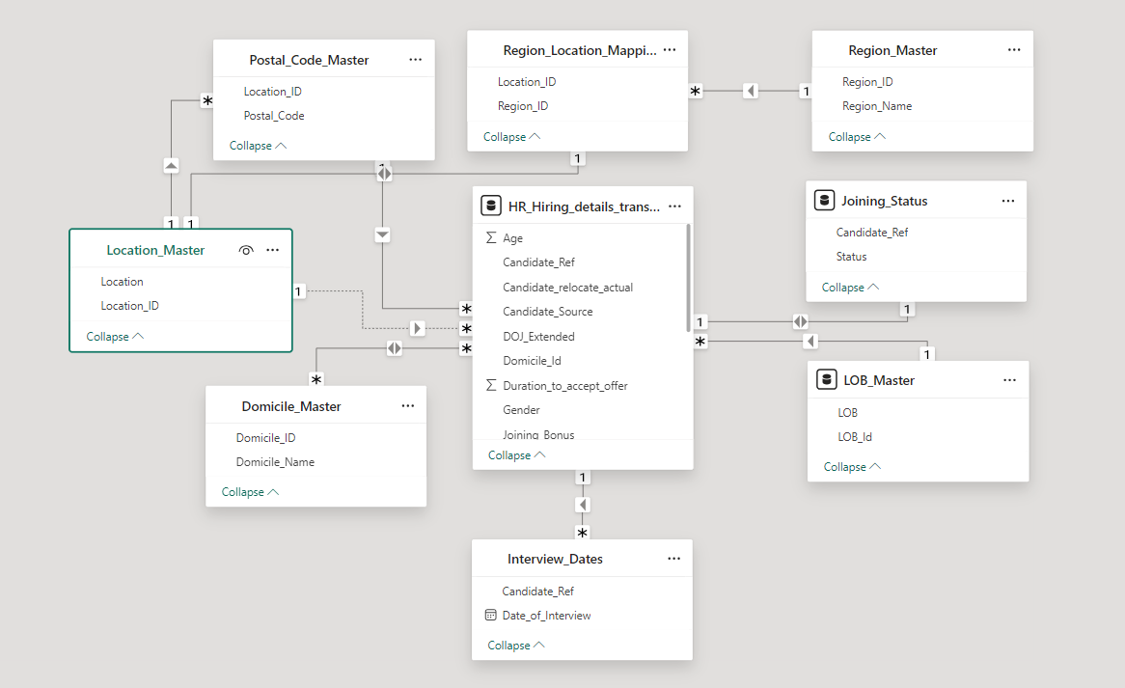
UML-Diagram

Slide 6
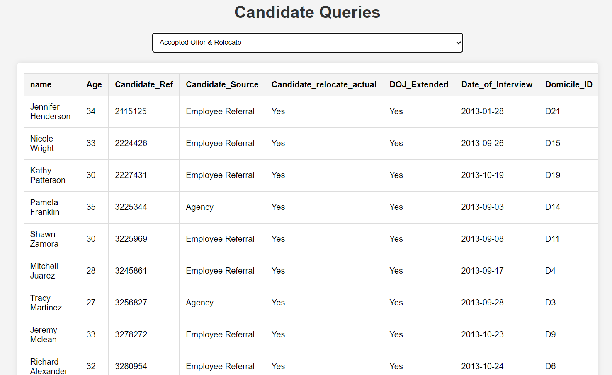
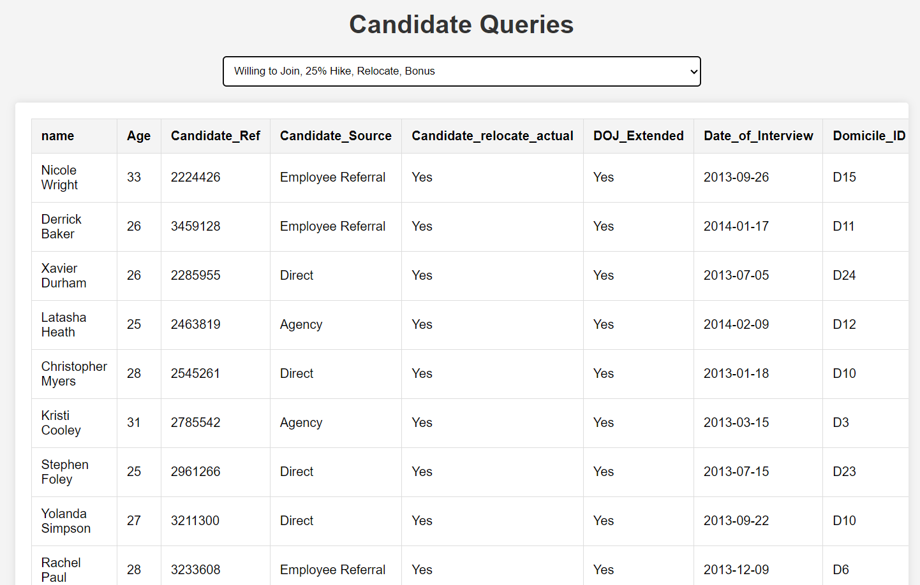
Queries Output
Accepted Offer & Relocate
Willing to Join, 25% Hike, Relocate, Bonus

Slide 7
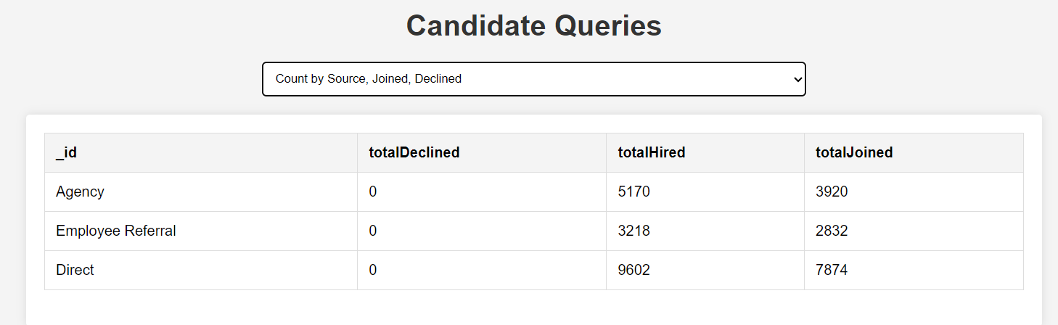
Queries Output
Count by Source, Joined, Declined

Slide 8
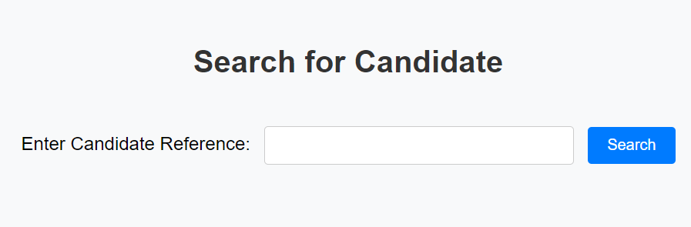
Flask Application
Search details of the Candidate according to their Reference Number.
Get the information about Candidate.

Slide 9
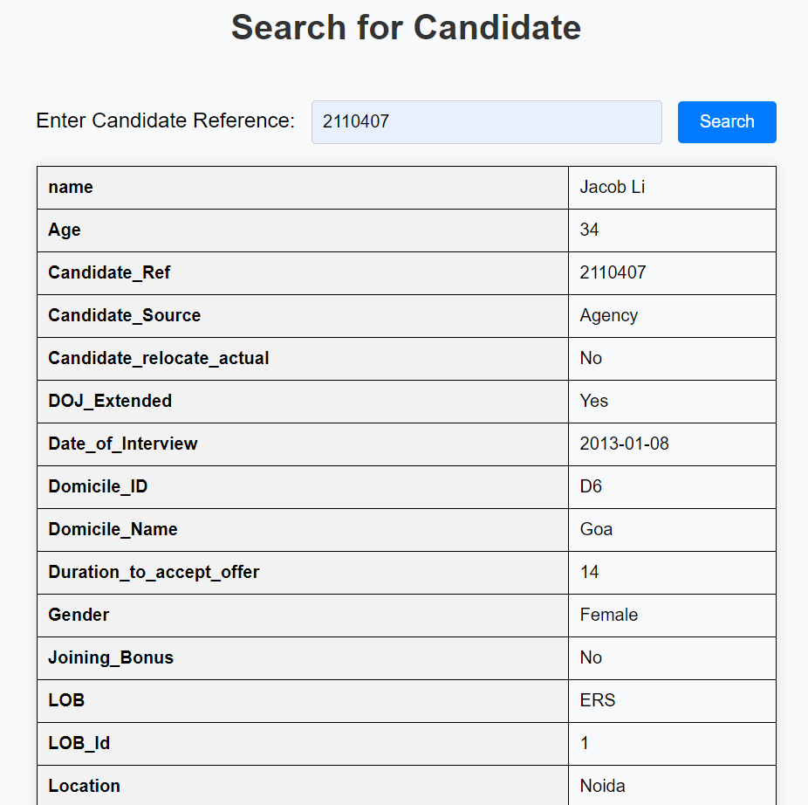

Slide 10
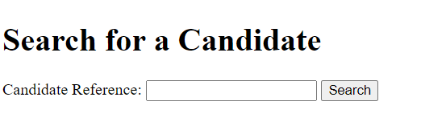
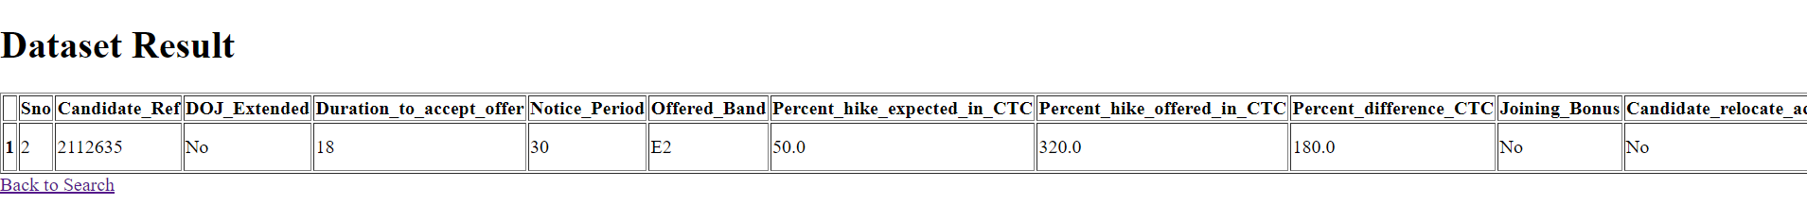
AWS Deployment
Searching Candidate
Displaying Result

Slide 11
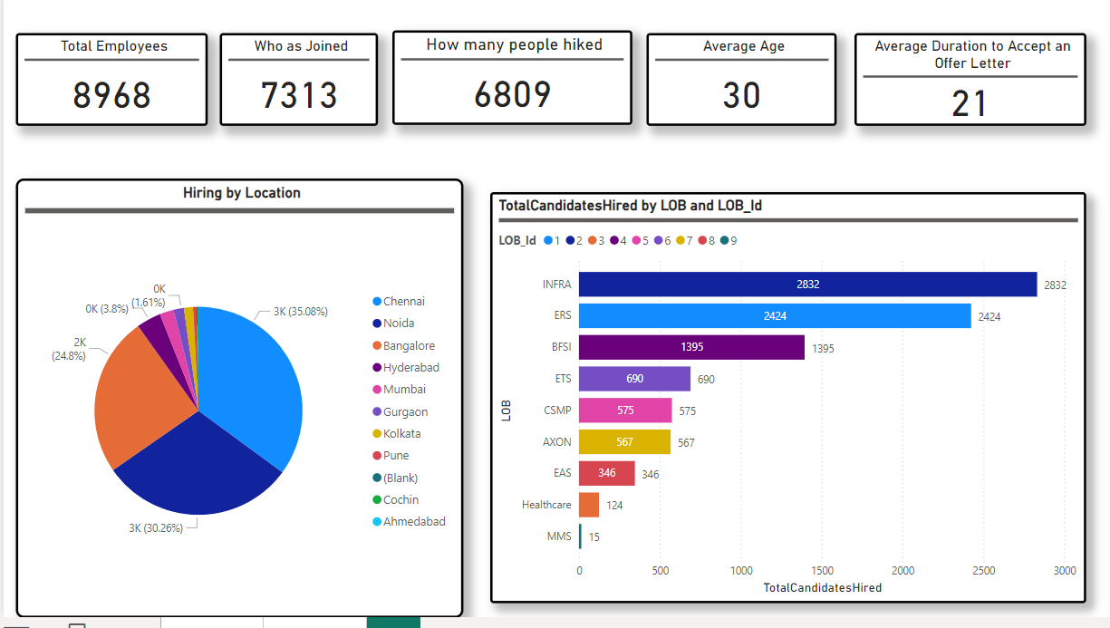
Power-BI Dashboard

Slide 12
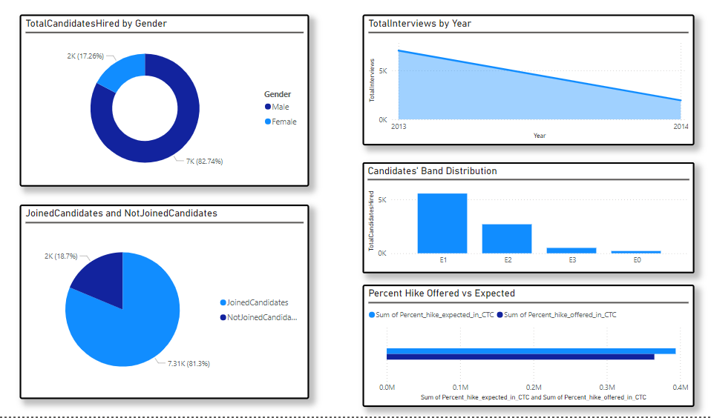

Slide 13
Business Improvement Recommendations:
1. Diversity and Inclusion:
Current Insight: There is a significant gender gap with 82.74% male hires and only 17.26% female hires.
Recommendation: Implement targeted recruitment programs to attract more female candidates and diversify the workforce.
Retention Strategy:
Current Insight: A significant portion of candidates (18.7%) did not join despite being hired.
Recommendation: Investigate the reasons behind candidates not joining and improve the onboarding process and offer acceptability.

Slide 14
Geographical Distribution :
Current Insight: Hiring is concentrated in Chennai, Bangalore, and Hyderabad.
Recommendation: Explore and expand hiring to other regions to tap into diverse talent pools and reduce dependency on specific locations
LOB Focus :
Current Insight: Most hires are concentrated in INFRA and ERS.
Recommendation: Assess the growth and hiring needs of underrepresented LOBs like Healthcare and MMS to ensure balanced development across all areas.
5. Interview Trends :
Current Insight: There is a decline in total interviews year-over-year.
Recommendation: Reevaluate the interview process and candidate sourcing strategies to ensure a steady pipeline of talent.

Slide 15
Thank You
Any Questions?

